Slide 1
Convolution Neural Network Models (CNN) Using tf.Keras

Slide 2
NVIDIA Contacts
Kris Keipert
Solutions Architect
kkeipert@nvidia.com
Marc West
Account Manager
marcw@nvidia.com

Slide 3
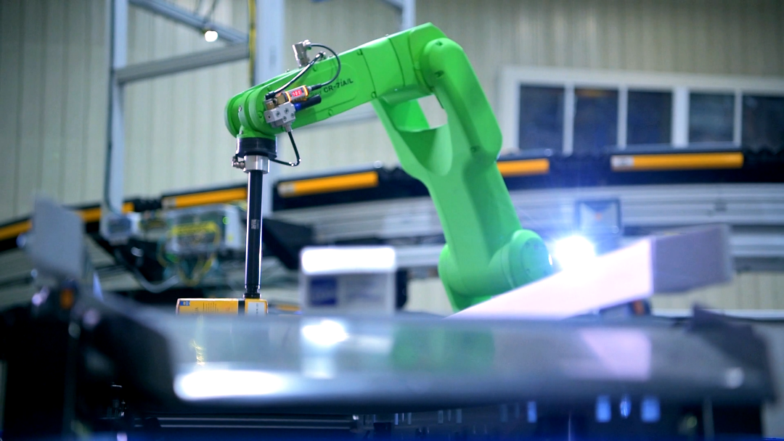
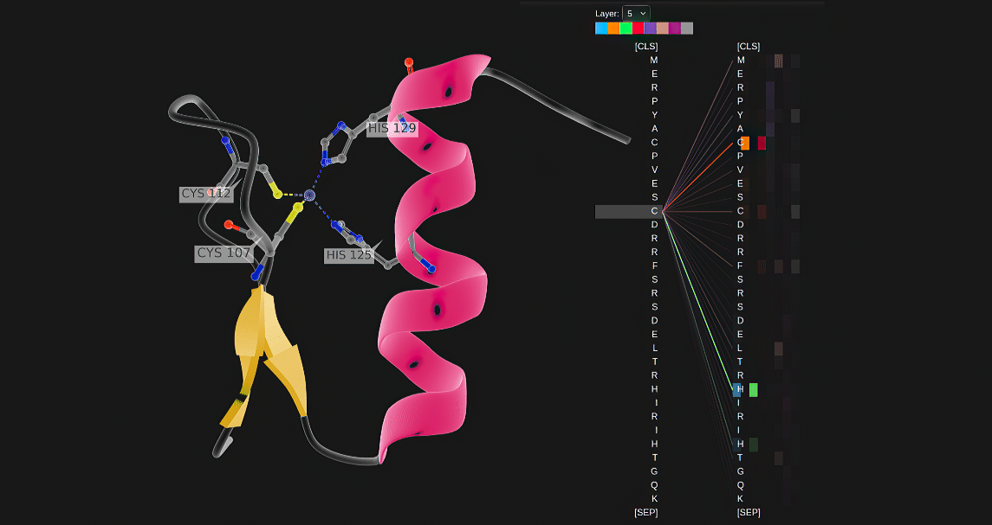
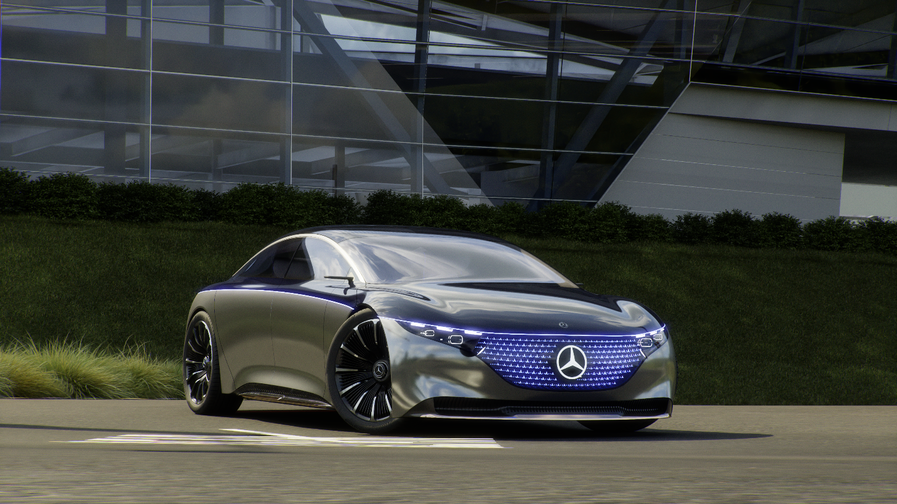
THE CONFERENCE FOR AI INNOVATORS, TECHNOLOGISTS, AND CREATIVES
Join us at GTC 2021 on April 12 - 16 for the latest in AI, HPC, healthcare, game development, networking, and more.
NVIDIA’s GTC brings together a global community of developers, researchers, engineers, and innovators to experience global innovation and collaboration.
Don’t miss out on the exclusive GTC keynote by Jensen Huang on April 12, available to everyone.
Visit www.nvidia.com/gtc to learn more and be notified when registration opens.

Slide 4



GET HANDS-ON INSTRUCTOR-LED TRAINING ONLINE AT GTC 2021
The NVIDIA Deep Learning Institute (DLI) offers in-depth workshops taught by subject matter experts to help you solve your most challenging problems in AI, accelerated computing, and data science.​
Spots are limited — visit www.nvidia.com/GTC to learn more and be notified when registration opens. ​
DLI workshops at NVIDIA GTC start Monday, April 12, 2021.​
APRIL 12 - 16, 2021 | www.nvidia.com/GTC

Slide 5

gpuhackathons.org

Slide 6

Last month’s materials:
github.com/keipertk/fdnn

Slide 7

github.com/keipertk/cnn-workshop

Slide 8


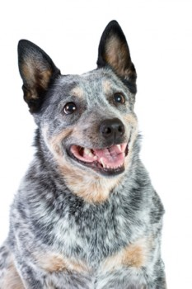
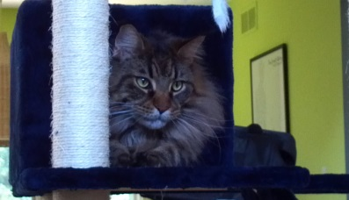
Machine Learning Software
Forward Propagation
Repeat
“turtle”
Tree
Backward Propagation
Cat
Training
Trained Model
Compute weight update to nudge
from “turtle” towards “dog”
Dog
Inference
“cat”
Notes:
How can we train the Neural Networks.
We are in the case of supervised learning, this means that we have pairs of input images and their corresponding desired output.
We now present the image of the dog to the input layer of the NN.
The NN forward propagates the input image through the hidden layers to the last layer, the output layer.
As we have already described, every neuron in the hidden layer computes an input value by taking the weighted sum of connected neurons in the previous layer, and applies a threshold function to compute the output value.
Once we are in the last layer we can compute an error between the desired output (here a dog) and the computed output (here turtle). We can now backpropagate the error and adapt the weights (our only free parameters) through a gradient based rule to minimize this error.
Now we have to do the same process for the image of the cat, to retrieve the cat, and the image of the tree to retrieve a tree.
Once we found a set of weights that correctly classifies all examples in the training set, we can stop the training process.
We can now extract the trained model and use it for inference.
The neural network is able to correctly classify new images that have not been in the training set.
Here for example we show a completely new picture of a cat and the network will identify it correctly to be a cat.
While training needs a lot of GPU power, Inference is a computationally very light and can run very well on all embedded machines, for example.

Slide 9
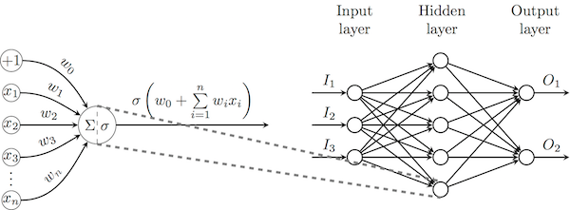
Multi-layer perceptron
Multi-layer Perceptron – several perceptrons
Includes bias (w₀) per neuron
Cybenko's universal approximation theorem, a (wide enough) MLP with a single hidden layer of sigmoid neurons is capable of approximating any continuous real function on a bounded interval
The proof of this theorem is not constructive, and therefore does not offer an efficient training algorithm for learning such structures in general

Slide 10
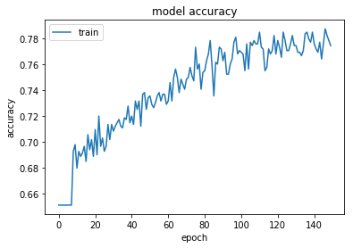
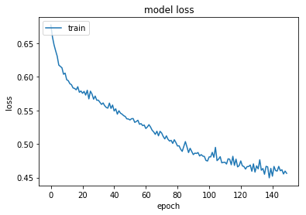
Visualize Training History

Slide 11
Image Problems
Before Neural Networks, image recognition was very difficult
Lots of hand coding. What features are important?
Classification, bounding box, segmentation…
Most codes could be defeated by rotating image or changing colors (or both)
Yann LeCun thought of using the convolution operator as an activation function in a Neural Network model
The use of DNN’s and CNN’s exploded after this

Slide 12
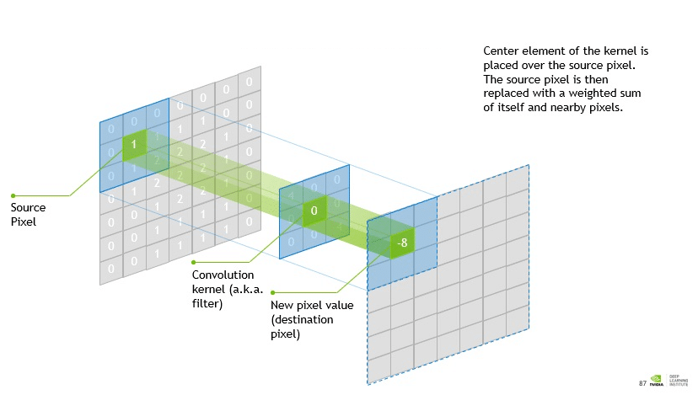
Convolution
The convolutional layer does most of the computational heavy lifting in a CNN.
It acts as the mathematical filters that help computers find edges of images, dark and light areas, colors, and other details, such as height, width and depth.

Slide 13
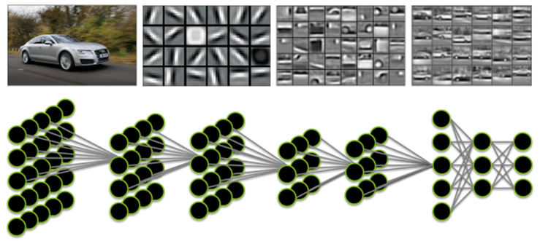
How a deep neural network sees

Slide 14

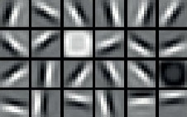
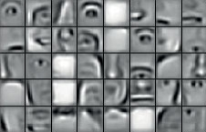
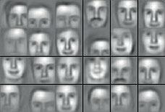
What Is Deep Learning?
Typical Network
Task objective
e.g. Identify face
Training data
10-100M images
Network architecture
10 layers
1B parameters
Learning algorithm
~30 Exaflops
~30 GPU days
Notes:
Now let us look at a typical convolutional network.
This network was set up for face identification.
Deep neural networks can only be trained with large datasets, using large amounts of computation.
The number of training images is between 10M and 100M images.
The network has 10 layers, and a total of 1B parameters.
It takes about 30 GPU days to train.
Now let us look what the CC network learned after training.
When we present an image to the input layer we can actually visualize how the network is doing the face identification.
Each layer of the network provides abstraction, by learning progressively higher-level features of the data.
The second picture from the left shows the activations from the layer close to the input layer.
We can see that it has learned the basic edge detection filters and much more that we know well from classical image processing.
This allows the network extract all basic features of the input.
Later layers respond to compositions of these low-level features that occur often in faces, such as eyes and noses.
The final layers are responsive to particular faces being recognized.

Slide 15
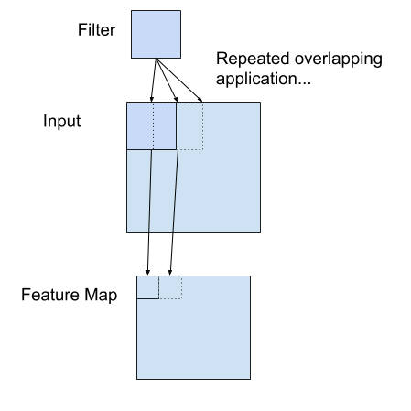
Advantages of cnn
An input (image) is filtered to produce a feature map
Input could be a feature map
The filter is a set of LEARNED weights
Automatic feature extraction
Feature map can be passed through a ReLU, just like with FCN
Advantages?
Retains spatial relationships between pixels
Resilient to rotation, distortion
Automatic feature extraction
Fewer weights than FCN
FCN might have a weight for each pixel
Very flexible
Stacking convolutions etc. to learn abstract features

Slide 16
Types of cnn layers
Convolutional Layer
Apply a convolution to an input, producing a feature map.
Pooling Layer
Feature maps are very sensitive to spatial positions of features in the input (local translation)
Downsample image to create “summarized” low-resolution version of features
Fully Connected Layer
As before. Introduce non-linear activation function, Softmax for prediction, etc.

Slide 17
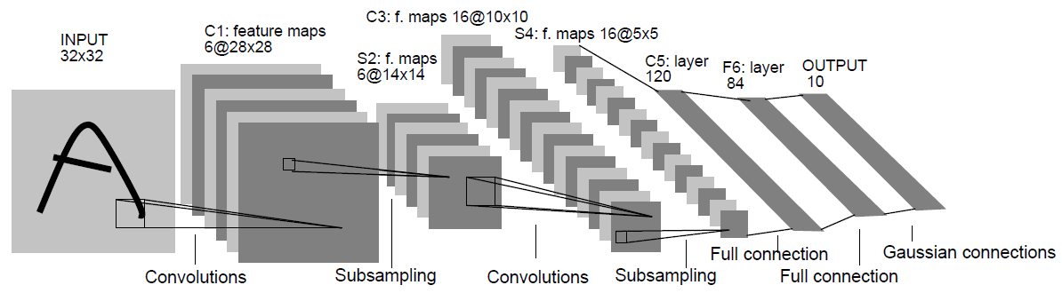

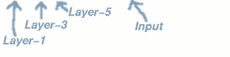
Original (Shallow) Convolutional Networks
Local receptive field + weight sharing
Yann LeCun et al, 1998
MNIST: 0.7% error rate
“Gradient-Based Learning Applied to Document Recognition”, Proceedings of the IEEE 1998, http://yann.lecun.com/exdb/lenet/index.html
Notes:
Feed Forward Fully Connected NN have been disappointing in image processing because of their spatial ignorance and huge number of weights that had to be adapted.
But still of standard usage when DL is applied to images
Yann LeCun and Joshua Bengio took inspiration from neurobiology and tried to capture the organization of neurons in the visual cortex of the cat.
Instead of having a fully connected layer, they propose to use convolutional filters that run over the input image and do feature extraction into a certain number of feature maps.
This reduces drastically the number of weights as only the weights of the filter have to be computed.
Once it is extracted, the feature maps are downsampled to reduce the dimension.
Repeat these steps until your left with sufficiently high level features. (here S4)
From here you continue with a normal FF NN in the last layers.
Filter1 and 2 5x5 => Input : 32x32 => 6 Feature Maps 28x28
C1 S2, C3 S4 always the same number of maps.
Weights do not overlap between maps.

Slide 18
MNIST

Slide 19
Object Classification (MNIST)
Object Classification or Recognition (what is the image?)
MNIST dataset was developed by Yann LeCun, Corinna Cortes and Christopher Burges for evaluating machine learning models on the handwritten digit classification problem
Constructed from a scanned document dataset available from the National Institute of Standards and Technology (NIST)
Variety of scanned documents, normalized in size and centered
28 by 28 pixels square (784 pixels total), grayscale (0..255)
60,000 images are used in training, 10,000 images are used to test it
10 digits (0 to 9) or 10 classes to predict
Results are reported using prediction error, which is nothing more than the inverted classification accuracy.
Notes:
https://machinelearningmastery.com/handwritten-digit-recognition-using-convolutional-neural-networks-python-keras/

Slide 20
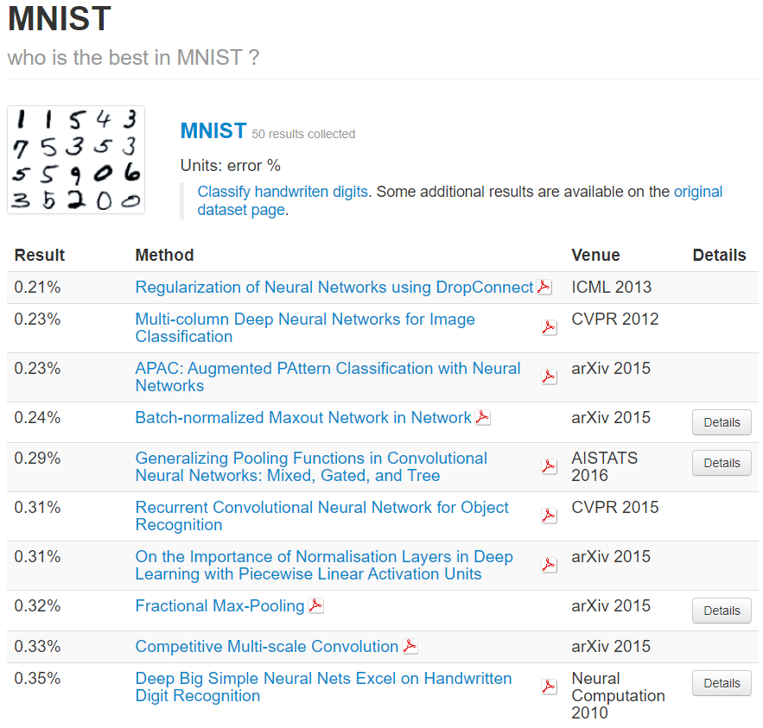
Object Classification (MNIST)
Excellent results achieve a prediction error of less than 1%
State-of-the-art prediction error of approximately 0.2% with large Convolutional Neural Networks
There is a listing of the state-of-the-art results and links to the relevant papers on the MNIST and other datasets on Rodrigo Benenson’s webpage

Slide 21
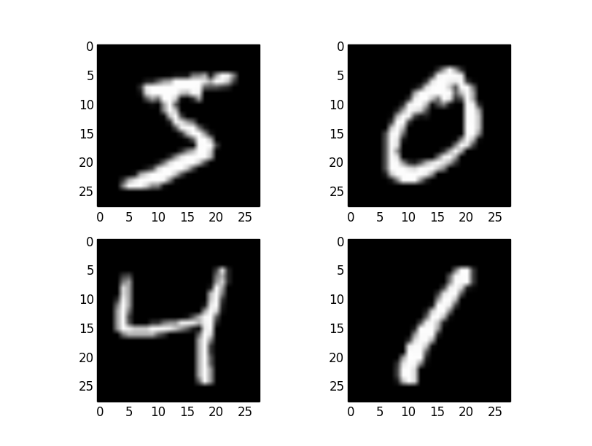
Load Data – Sample Output

Slide 22
Single Perceptron Layer

Slide 23
Single Layer Perceptron Model
Let’s use what we learned - Fully Connected Networks (FCN)
Start with a single layer Perceptron
Can it do image recognition?

Slide 24
Create model
import numpy
Import tensorflow as tf
(train_x, train_y), (test_x, test_y) =
tf.keras.datasets.mnist.load_data ()
train_x = train_x.astype('float32') / 255
test_x = test_x.astype('float32') / 255
print("Training data, X shape = ", train_x.shape)
print("Training data, y shape = ", train_y.shape)
print("Test data, x shape = ", test_x.shape)
print("Test data, y shape = ", test_y.shape)
train_x = train_x.reshape(60000,784)
test_x = test_x.reshape(10000,784)
train_y = tf.keras.utils.to_categorical (train_y,10)
test_y = tf.keras.utils.to_categorical (test_y,10)
Keras already has MNIST available
60,000 images and labels for training
10,000 images and labels for testing
Converted to Numpy arrays
Convert 28x28 array to 1D vector (784)
Convert labels to categories (10 of them)

Slide 25
Create Model
# create model
model = tf.keras.models.Sequential()
model.add(tf.keras.layers.Dense(num_pixels,
input_dim=num_pixels, kernel_initializer='normal’,
activation='relu'))
model.add(tf.keras.layers.Dense(num_classes,
kernel_initializer='normal’
activation='softmax'))
# Compile model
model.compile(loss='categorical_crossentropy’,
optimizer='adam', metrics=['accuracy'])
model.summary()
return model
# end def
model = Sequential()
model.add(Dense(units=128,activation="relu",input_shape=(784,)))
model.add(Dense(units=10,activation="softmax"))
model.compile(optimizer=‘adam’,loss="categorical_crossentropy",metrics=["accuracy"])
# Model.summary
print("Model Summary:")
model.summary()
print(" ")
One FCN layer
128 neurons
Use softmax for output layer
Great for classifications
Print out model
model.summary()

Slide 26
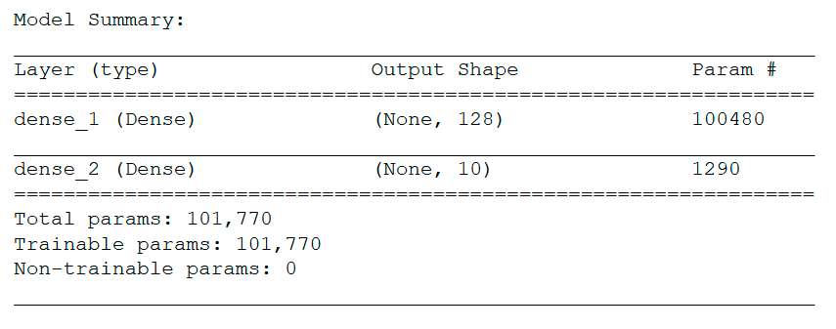
Create Model

Slide 27
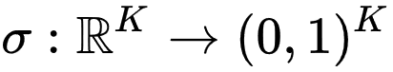
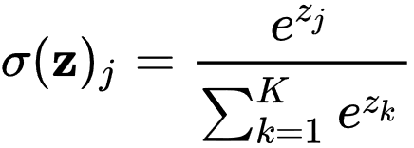
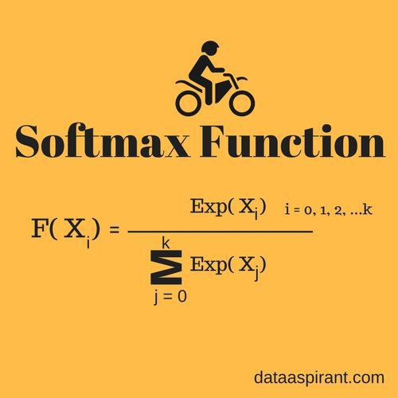
Activation Function - Softmax
In mathematics, the softmax function, or normalized exponential function, is a generalization of the logistic function (In Keras, ‘softmax’)
Neural Networks are commonly trained under a log loss (or cross-entropy) regime
Probabilities will be in range of 0 to 1
Sum of all probabilities is 1

Slide 28
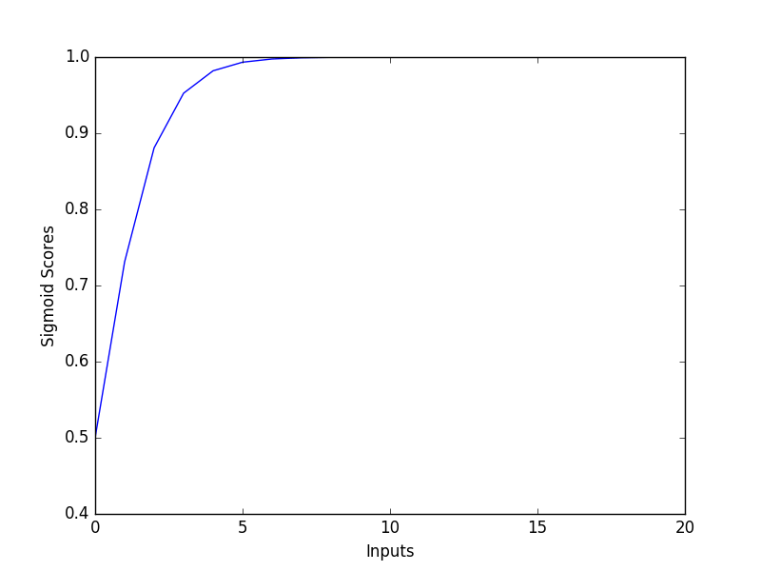
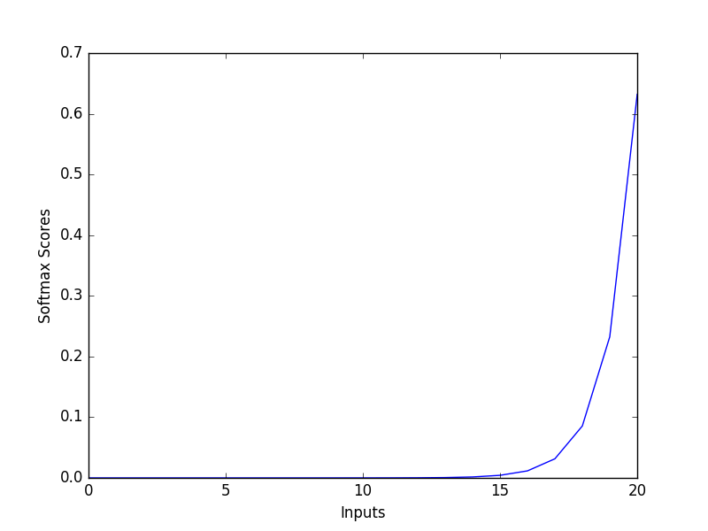
Activation Function - Softmax

Slide 29
TRAIN
Collect training history
Batch size of 32
10 Epochs (just a start)
Compute total training time
Evaluate accuracy of test images
Print out accuracy of first image
# Train
import time
start_time = time.time()
history = model.fit(train_x,train_y, batch_size=32,
epochs=10, verbose=1)
end_time = time.time()
accuracy = model.evaluate(x=test_x,y=test_y,batch_size=32)
print("Accuracy: ",accuracy[1])

Slide 30
POST-PROCESSING
Plot accuracy and loss history
Print out total training time
import matplotlib.pyplot as plt
plt.plot(history.history['acc'])
plt.title('model accuracy')
plt.ylabel('accuracy')
plt.xlabel('epoch')
plt.legend(['train'], loc='upper left')
plt.show()
# summarize history for loss
plt.plot(history.history['loss'])
plt.title('model loss')
plt.ylabel('loss')
plt.xlabel('epoch')
plt.legend(['train'], loc='upper left')
plt.show()
# total training time
print(" ")
print("Total training time = ",(end_time - start_time)," seconds")

Slide 31
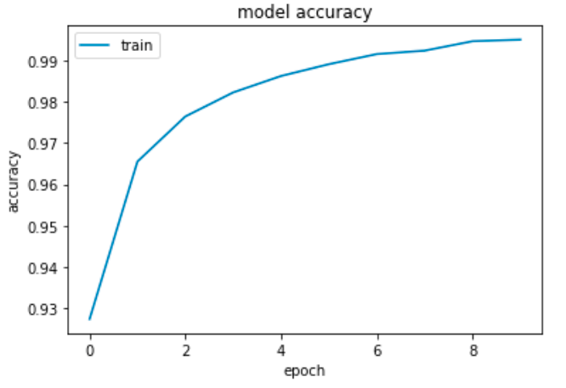
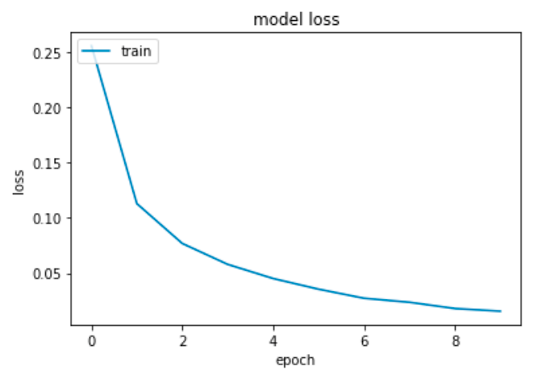
POST PROCESSING

Slide 32
Longer training
Try longer training
100 Epochs
What happened?
Training data:
Loss = 0.002 (started at 0.281)
Accuracy = 0.999 (started at 0.919)
Validation data:
Loss = 0.168 (started at 0.212)
Accuracy = 0.982 (started at 0.957)
Over-trained?

Slide 33
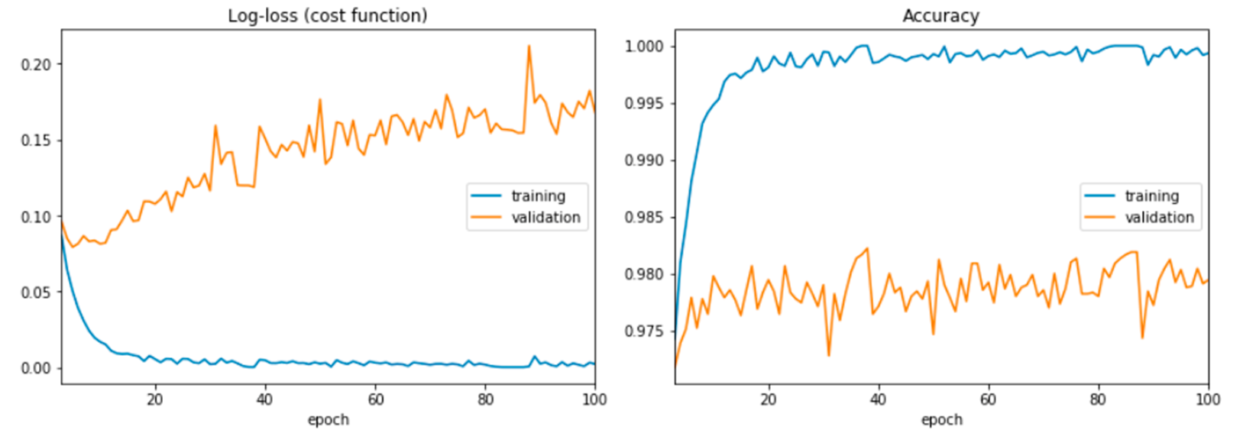
AFTER 100 EPOCHS

Slide 34
FCN Summary
After 10 epochs
About 99.5% accuracy (started at about 92.7%)
Loss of less than 0.0157 (started a bit above 0.255)
What happens with a longer training time?
Training data:
Loss = 0.002 (started at 0.281)
Accuracy = 0.999 (started at 0.919)
Validation data:
Loss = 0.168 (started at 0.212)
Accuracy = 0.982 (started at 0.957)
Over-fitting?
Notes:
https://machinelearningmastery.com/handwritten-digit-recognition-using-convolutional-neural-networks-python-keras/

Slide 35
Building the cnn
# reshape to be [samples][pixels][width][height]
X_train = X_train.reshape(X_train.shape[0], 1, 28, 28).astype('float32’)
X_test = X_test.reshape(X_test.shape[0], 1, 28, 28).astype('float32')
2d convolution layers in Keras require pixel values with dimensions [samples][pixels][width][height]
Pixels is the number of color channels. 1 for greyscale. 3 for RGB.
Let’s build a simple CNN that showcases all the layers we discussed

Slide 36
Building the cnn
def baseline_model():
# create model
model = tf.keras.models.Sequential()
model.add(tf.keras.layers.Conv2D(32, (5, 5), input_shape=(1, 28, 28), data_format = 'channels_first',
activation='relu'))
model.add(tf.keras.layers.MaxPooling2D(pool_size=(2, 2)))
model.add(tf.keras.layers.Dropout(0.2))
model.add(tf.keras.layers.Flatten())
model.add(tf.keras.layers.Dense(128, activation='relu'))
model.add(tf.keras.layers.Dense(num_classes, activation='softmax'))
# Compile model
model.compile(loss='categorical_crossentropy', optimizer='adam', metrics=['accuracy'])
model.summary()
return model
Sequential model
We’re building our model up sequentially with a list of layers

Slide 37
Building the cnn
def baseline_model():
# create model
model = tf.keras.models.Sequential()
model.add(tf.keras.layers.Conv2D(32, (5, 5), input_shape=(1, 28, 28), data_format = 'channels_first',
activation='relu'))
model.add(tf.keras.layers.MaxPooling2D(pool_size=(2, 2)))
model.add(tf.keras.layers.Dropout(0.2))
model.add(tf.keras.layers.Flatten())
model.add(tf.keras.layers.Dense(128, activation='relu'))
model.add(tf.keras.layers.Dense(num_classes, activation='softmax'))
# Compile model
model.compile(loss='categorical_crossentropy', optimizer='adam', metrics=['accuracy'])
model.summary()
return model
Convolution Layer
Convolution2D
32 feature maps
5x5 filter
Rectifier activation function

Slide 38
Building the cnn
def baseline_model():
# create model
model = tf.keras.models.Sequential()
model.add(tf.keras.layers.Conv2D(32, (5, 5), input_shape=(1, 28, 28), data_format = 'channels_first',
activation='relu'))
model.add(tf.keras.layers.MaxPooling2D(pool_size=(2, 2)))
model.add(tf.keras.layers.Dropout(0.2))
model.add(tf.keras.layers.Flatten())
model.add(tf.keras.layers.Dense(128, activation='relu'))
model.add(tf.keras.layers.Dense(num_classes, activation='softmax'))
# Compile model
model.compile(loss='categorical_crossentropy', optimizer='adam', metrics=['accuracy'])
model.summary()
return model
Pooling Layer
MaxPooling2D
2x2 pool size (de facto standard)
Takes the max value

Slide 39
Building the cnn
def baseline_model():
# create model
model = tf.keras.models.Sequential()
model.add(tf.keras.layers.Conv2D(32, (5, 5), input_shape=(1, 28, 28), data_format = 'channels_first',
activation='relu'))
model.add(tf.keras.layers.MaxPooling2D(pool_size=(2, 2)))
model.add(tf.keras.layers.Dropout(0.2))
model.add(tf.keras.layers.Flatten())
model.add(tf.keras.layers.Dense(128, activation='relu'))
model.add(tf.keras.layers.Dense(num_classes, activation='softmax'))
# Compile model
model.compile(loss='categorical_crossentropy', optimizer='adam', metrics=['accuracy'])
model.summary()
return model
Regularization Layer
Dropout
Randomly exclude 20% of neurons
Reduces overfitting

Slide 40
Building the cnn
def baseline_model():
# create model
model = tf.keras.models.Sequential()
model.add(tf.keras.layers.Conv2D(32, (5, 5), input_shape=(1, 28, 28), data_format = 'channels_first',
activation='relu'))
model.add(tf.keras.layers.MaxPooling2D(pool_size=(2, 2)))
model.add(tf.keras.layers.Dropout(0.2))
model.add(tf.keras.layers.Flatten())
model.add(tf.keras.layers.Dense(128, activation='relu'))
model.add(tf.keras.layers.Dense(num_classes, activation='softmax'))
# Compile model
model.compile(loss='categorical_crossentropy', optimizer='adam', metrics=['accuracy'])
model.summary()
return model
Preparing data for FC layers
Flatten
Converts 2D matrix data into a vector
Now we can proceed to fully connected layers

Slide 41
Building the cnn
def baseline_model():
# create model
model = tf.keras.models.Sequential()
model.add(tf.keras.layers.Conv2D(32, (5, 5), input_shape=(1, 28, 28), data_format = 'channels_first',
activation='relu'))
model.add(tf.keras.layers.MaxPooling2D(pool_size=(2, 2)))
model.add(tf.keras.layers.Dropout(0.2))
model.add(tf.keras.layers.Flatten())
model.add(tf.keras.layers.Dense(128, activation='relu'))
model.add(tf.keras.layers.Dense(num_classes, activation='softmax'))
# Compile model
model.compile(loss='categorical_crossentropy', optimizer='adam', metrics=['accuracy'])
model.summary()
return model
Fully connected layer
128 neurons
Rectifier activation function

Slide 42
Building the cnn
def baseline_model():
# create model
model = tf.keras.models.Sequential()
model.add(tf.keras.layers.Conv2D(32, (5, 5), input_shape=(1, 28, 28), data_format = 'channels_first',
activation='relu'))
model.add(tf.keras.layers.MaxPooling2D(pool_size=(2, 2)))
model.add(tf.keras.layers.Dropout(0.2))
model.add(tf.keras.layers.Flatten())
model.add(tf.keras.layers.Dense(128, activation='relu'))
model.add(tf.keras.layers.Dense(num_classes, activation='softmax'))
# Compile model
model.compile(loss='categorical_crossentropy', optimizer='adam', metrics=['accuracy'])
model.summary()
return model
Output layer
10 layers for 10 classes [0-9]
Softmax activation function. Gives probability for each class.

Slide 43
Building the cnn
def baseline_model():
# create model
model = tf.keras.models.Sequential()
model.add(tf.keras.layers.Conv2D(32, (5, 5), input_shape=(1, 28, 28), data_format = 'channels_first',
activation='relu'))
model.add(tf.keras.layers.MaxPooling2D(pool_size=(2, 2)))
model.add(tf.keras.layers.Dropout(0.2))
model.add(tf.keras.layers.Flatten())
model.add(tf.keras.layers.Dense(128, activation='relu'))
model.add(tf.keras.layers.Dense(num_classes, activation='softmax'))
# Compile model
model.compile(loss='categorical_crossentropy', optimizer='adam', metrics=['accuracy'])
model.summary()
return model
Model compilation
Logarithmic loss
ADAM gradient descent

Slide 44
CNN Results
How does your accuracy compare to the FCN?
Consider running a few times and take an average
What if you increase the number of epochs?
How about the runtime?
Let’s get a little bit closer to state of the art.
Notes:
https://machinelearningmastery.com/handwritten-digit-recognition-using-convolutional-neural-networks-python-keras/

Slide 45
Building a larger cnn
model.add(tf.keras.layers.Conv2D(30, (5, 5), input_shape=(1, 28, 28), data_format = 'channels_first',
activation='relu'))
model.add(tf.keras.layers.MaxPooling2D(pool_size=(2, 2)))
model.add(tf.keras.layers.Conv2D(15, (3, 3), data_format = 'channels_first', activation='relu'))
model.add(tf.keras.layers.MaxPooling2D(pool_size=(2, 2)))
model.add(tf.keras.layers.Dropout(0.2))
model.add(tf.keras.layers.Flatten())
model.add(tf.keras.layers.Dense(128, activation='relu'))
model.add(tf.keras.layers.Dense(50, activation='relu'))
model.add(tf.keras.layers.Dense(num_classes, activation='softmax'))
Larger model
Extra convolutional, pooling, and FC layers

Slide 46
Larger CNN Results
How does your accuracy compare to the FCN and smaller CNN?
Consider running a few times and take an average
What if you increase the number of epochs?
How about the runtime?
Look at networks in recent publications for inspiration
Notes:
https://machinelearningmastery.com/handwritten-digit-recognition-using-convolutional-neural-networks-python-keras/

